Slide 1


OBJECT ORIENTED PROGRAMMING THROUGH JAVA

Slide 2

L4 - JVM ARCHITECTURE

Slide 3


Slide 4
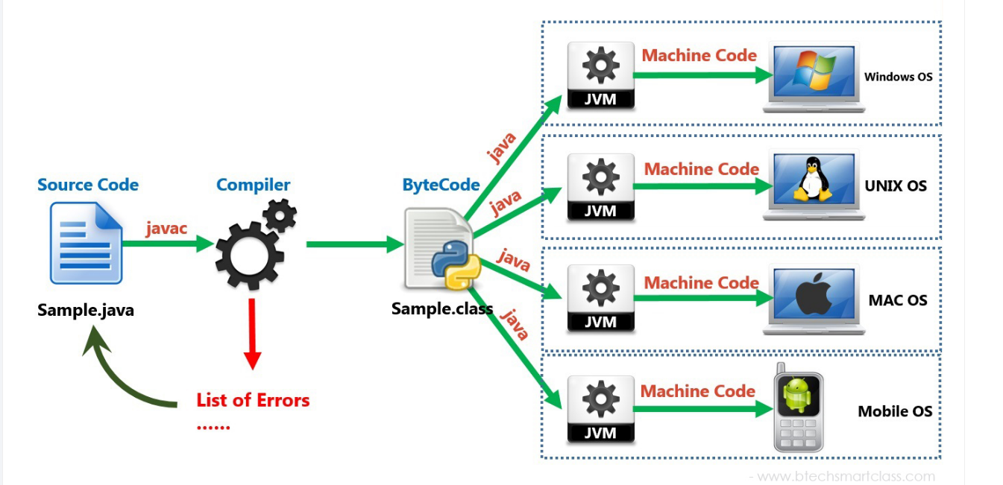
JVM ARCHITECTURE:-
JVM is the core of the Java ecosystem, and makes it possible for Java-based software programs to follow the "write once, run anywhere" approach. You can write Java code on one machine, and run it on any other machine using the JVM.

Slide 5
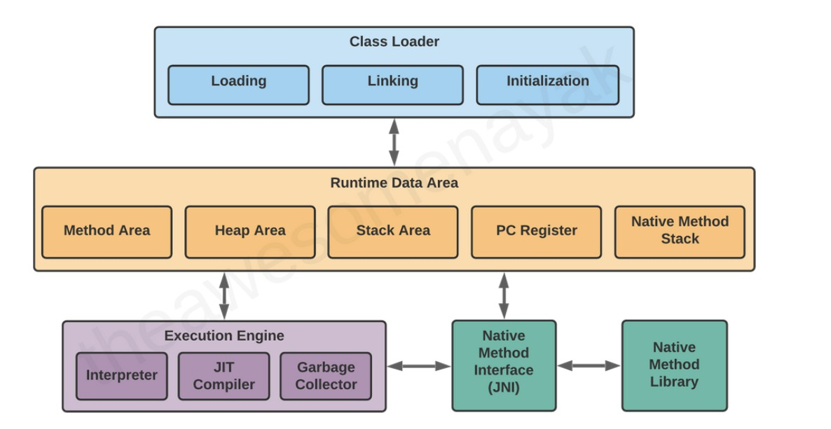
JVM ARCHITECTURE:-

Slide 6
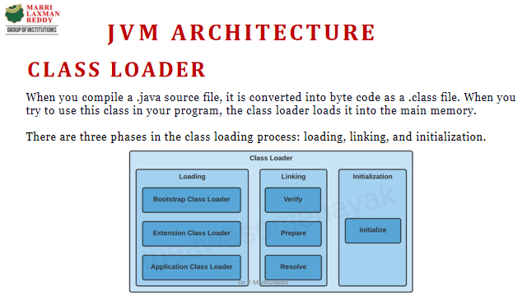

Slide 7
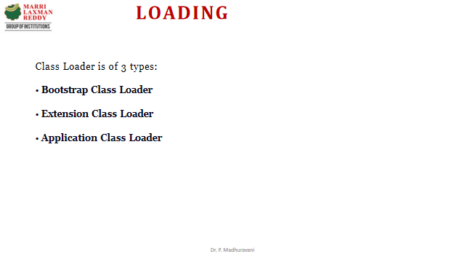

Slide 8
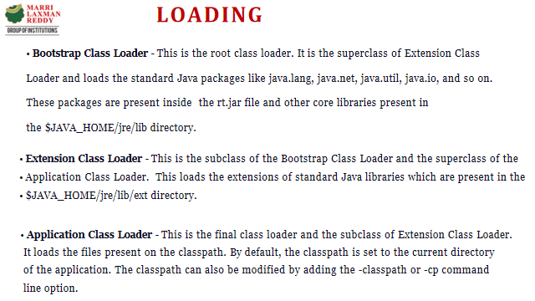

Slide 9
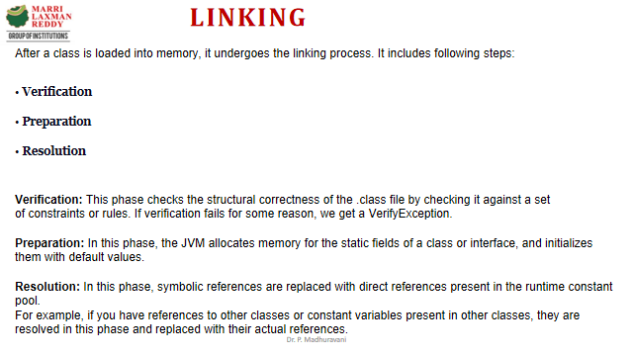

Slide 10
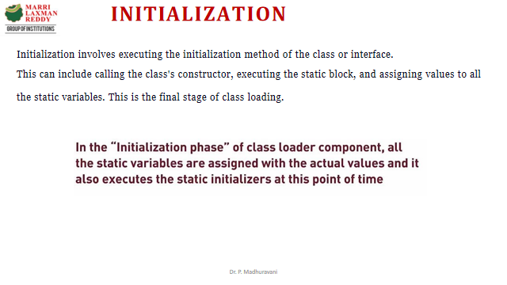

Slide 11
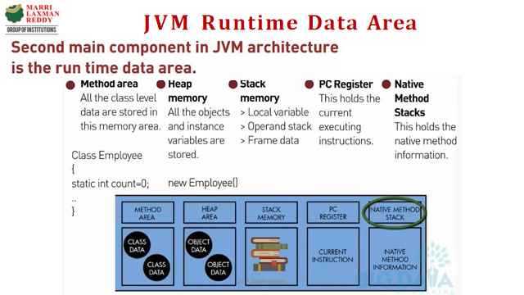

Slide 12
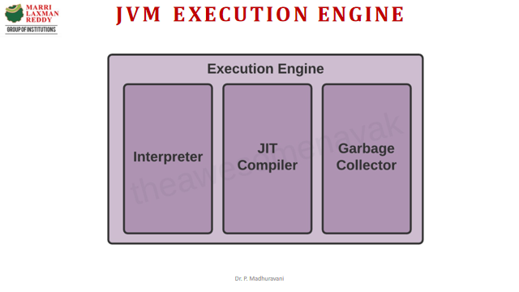

Slide 13
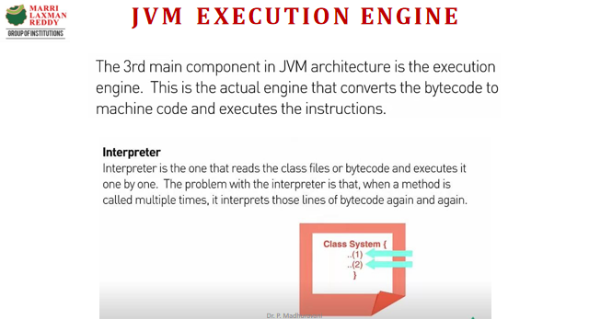

Slide 14
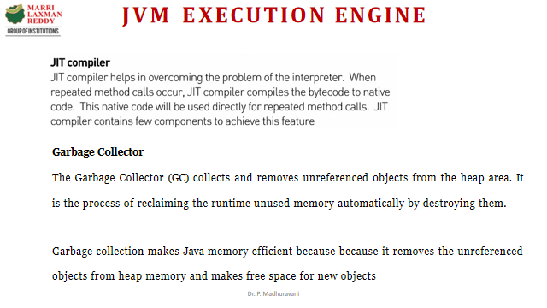

Slide 15
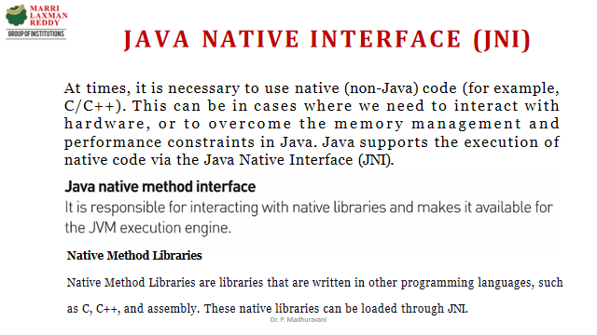

Slide 16
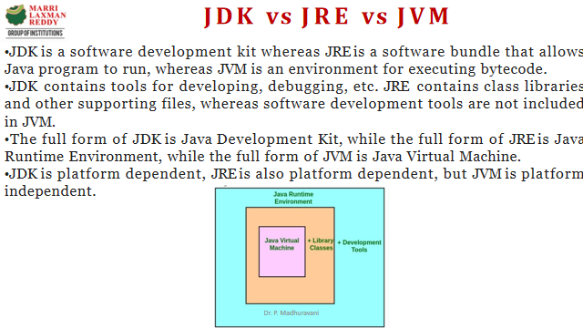

Slide 17
Next….
DATA TYPES
Notes:
In Slide Show mode, click the arrow to enter the PowerPoint Getting Started Center.

Slide 18



